Slide 1
SC2001 LAB 2
Team 4 Low Jia Qi Low Wei Jie Luke Eng Peng Kee

Slide 2
Contents of Project 2 - Djikstra Implementations
Adjacency Matrix
+
Array Queue
Adjacency List
+
Heap Queue
Comparison
Implementation & Time Complexity
Implementation & Time Complexity
Performance Comparison

Slide 3
Generating Graphs (Test Data)

Slide 4
Generating Graphs
Adjacency Matrix & Lists
Create identical graphs in both formats: adjacency matrix & adjacency lists
Edge Probability: chance of creating an edge between two vertices → determines graph density
Adjacency Matrix
Array of Adjacency Lists
def generate_random_graph(num_nodes, edge_prob=0.75, weight_range=(1, 10)):
adj_matrix = np.zeros((num_nodes, num_nodes), dtype=int)
adj_list = {i: [] for i in range(num_nodes)}
for i in range(num_nodes):
for j in range(i + 1, num_nodes):
if random.random() < edge_prob:
weight_ij = random.randint(*weight_range)
weight_ji = random.randint(*weight_range)
adj_matrix[i][j] = weight_ij
adj_matrix[j][i] = weight_ji
adj_list[i].append((j, weight_ij))
adj_list[j].append((i, weight_ji))
return {"adj_matrix": adj_matrix, "adj_lists": adj_list}
example_graph = generate_random_graph(5)
start_node = 0

Slide 5
(a)
Adjacency Matrix
+
Array Queue

Slide 6
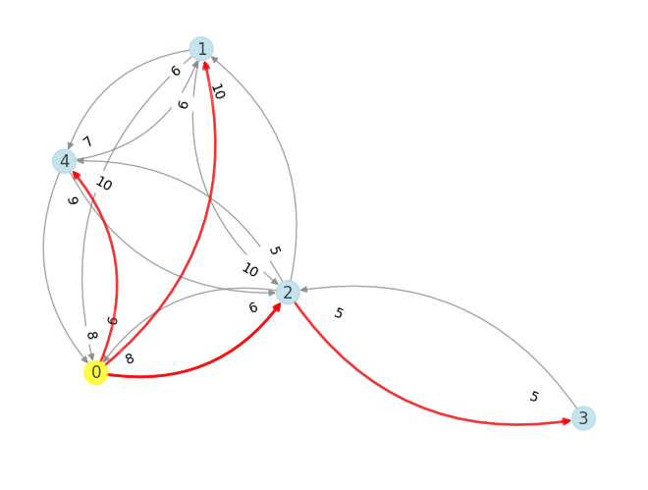
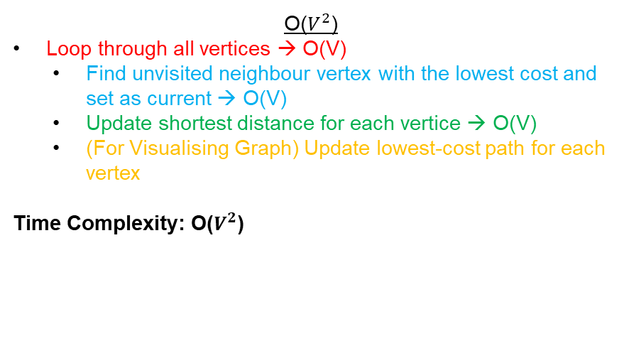
(a) Adjacency Matrix + Array Queue
def dijkstra_a(adj_matrix, start):
V = len(adj_matrix)
dist = [float('inf')] * V
prev = [None] * V
visited = [False] * V
dist[start] = 0 start_time = time.time()
for _ in range(V):
min_dist = float('inf')
u = None
for v in range(V):
if not visited[v] and dist[v] < min_dist:
min_dist = dist[v]
u = v
if u is None:
break
visited[u] = True
for v in range(V):
if adj_matrix[u][v] > 0 and not visited[v]:
new_dist = dist[u] + adj_matrix[u][v]
if new_dist < dist[v]:
dist[v] = new_dist
prev[v] = u
shortest_paths = {i: [] for i in range(V)}
for i in range(V):
if dist[i] < float('inf') and i != start:
path = []
curr = i
while curr is not None:
path.append(curr)
curr = prev[curr]
shortest_paths[i] = path[::-1]
execution_time = time.time() - start_time
return dist, shortest_paths, execution_time
Time Complexity
O($V^{2}$)
Loop through all vertices → O(V)
Find unvisited neighbour vertex with the lowest cost and set as current → O(V)
Update shortest distance for each vertice → O(V)
(For Visualising Graph) Update lowest-cost path for each vertex
Time Complexity: O($V^{2}$)

Slide 7
(b) Adjacency List + Heap Queue

Slide 8
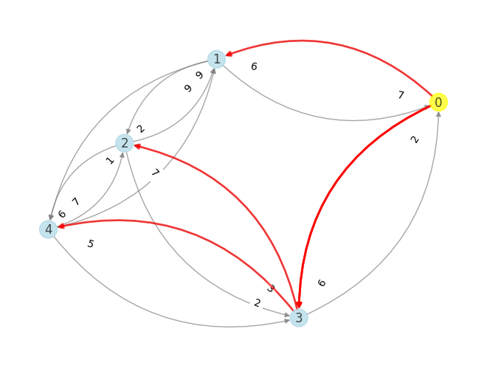
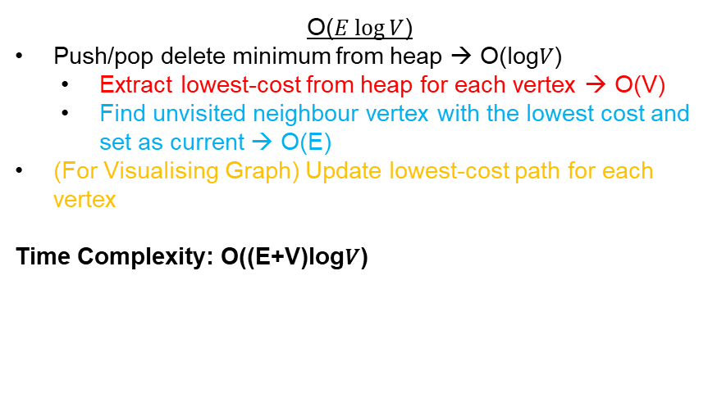
(b) Adjacency Lists + Heap Queue
def dijkstra_b(adj_list, start):
V = len(adj_list)
dist = {i: float('inf') for i in range(V)}
prev = {i: None for i in range(V)}
dist[start] = 0
pq = [(0, start)]
start_time = time.time()
while pq:
current_dist, u = heapq.heappop(pq)
if current_dist > dist[u]:
continue
for v, weight in adj_list[u]:
new_dist = dist[u] + weight
if new_dist < dist[v]:
dist[v] = new_dist
prev[v] = u
heapq.heappush(pq, (new_dist, v))
shortest_paths = {i: [] for i in range(V)}
for i in range(V):
if dist[i] < float('inf'):
path = []
node = i
while node is not None:
path.append(node)
node = prev[node]
shortest_paths[i] = path[::-1]
end_time = time.time()
execution_time = end_time - start_time
return dist, shortest_paths, execution_time
Time Complexity
O($E\log{V}$)
Push/pop delete minimum from heap → O(log⁡𝑉)
Extract lowest-cost from heap for each vertex → O(V)
Find unvisited neighbour vertex with the lowest cost and set as current → O(E)
(For Visualising Graph) Update lowest-cost path for each vertex
Time Complexity: O((E+V)log⁡𝑉)
Push/pop delete minimum vertex V times from heap → O(V log V)
Finding unvisited neighbour vertex E times (Insertion into the priority queue) → O (E log V)
Overall time complexity: O(V logV) + O(E logV) = O((E+V)logV)

Slide 9
(c) Performance Comparison

Slide 10
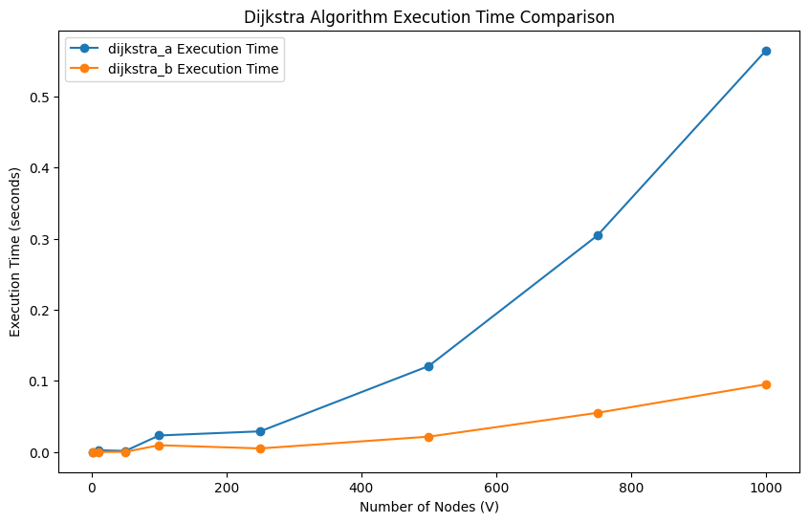
(c) Performance Comparison
The execution time is plotted against the number of Nodes (V)
Observations:
The adjacency matrix with array priority queue shows a sharp rise in execution time as the number of nodes grows due to the O(V²) complexity.
The adjacency list with a min-heap grows more gradually, indicating its better efficiency.

Slide 11
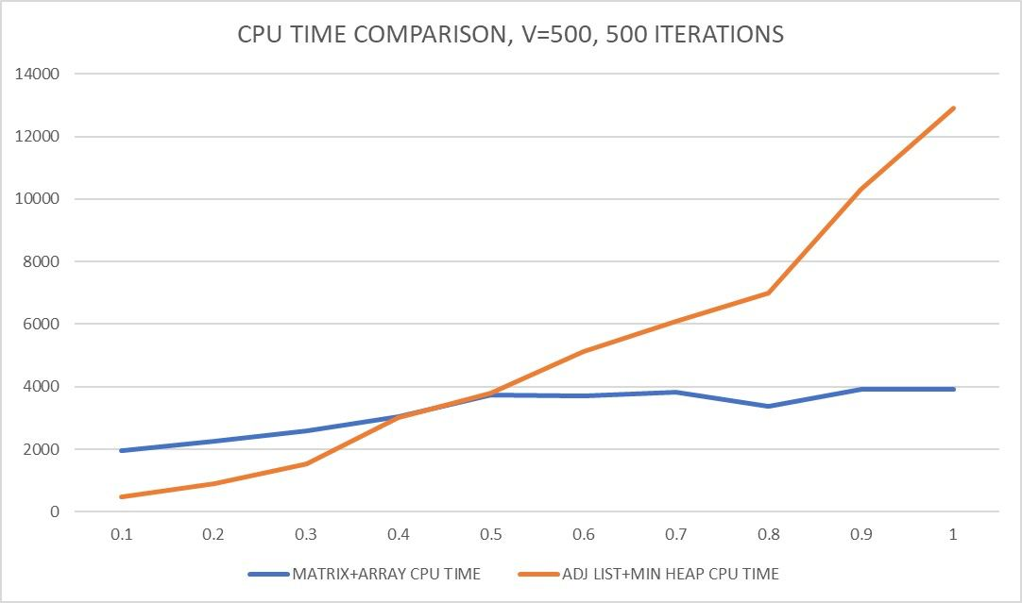
(c) Performance Comparison
The execution time is plotted against the number of edges (E)
Observations:
in sparse graph, The adjacency list with a min-heap 𝑂((𝑉 + 𝐸) log 𝑉) scales much better
For Dense graphs (E ≈ V²), the time complexity of The adjacency matrix with an array priority queue performs better
Adjacency List: O((V+E) logV) -> O((V+V²) logV) -> O(V² logV), which is worse than O(V²).

Slide 12
(c) Performance Comparison
Empirical Comparison
 | dijkstra_a (Adjacency Matrix + Array Queue) | dijkstra_b (Adjacency List + Heap Queue)
Find Lowest-Cost Vertex | O(V) (linear search) | O(log V) (heap extraction)
Updating Minimum Distances | O(V) (scan all vertices) | O(log V) (heap insert/update)
Time Complexity | O(V²) | O((V + E) log V)
Best Use Case | Dense graphs (E ≈ V²) | Sparse graphs (E ≪ V²)
Space Complexity | O(V²) | O(V + E)

Slide 13
Thank you!

